Slide 1
Performing Basic Tasks in Java

Slide 2
Topics We Will Cover Today
Taking in command line arguments
Primitives vs. Objects
Wrapper classes and Conversions
Taking Input and Output using Swing
Selection and Control Structures
OOP in java (Defining and using classes)
Notes:
Green Project…Goal was to do research on the application of computers in consumer electronic market. All of them talking to each other.
James Gosling modified C++ for this purpose…….named C++ ++ --
Then oak….then java
Wide range of manufacturers of electronic devices.
So should be platform independent……so interpreted language……not compiled one.

Slide 3
Last Lecture Example
File: HelloWorldApp.java
public class HelloWorldApp{
public static void main(String[] args) {
System.out.println("Hello world");
}
}
Notes:
Tell about
Public static void main()

Slide 4
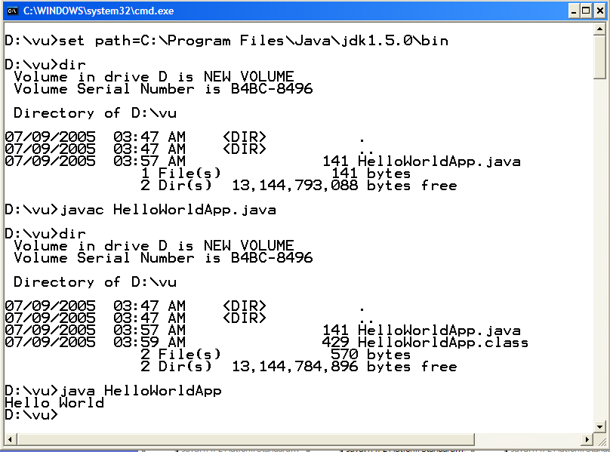
Compile and Execute

Slide 5
Things to remember
Name of file must match name of class
  It is case sensitive
Processing starts in main
  public static void main(String[] args)
Printing is done with System.out
  System.out.println, System.out.print
Compile with “javac”
  Open DOS/command prompt window; work from there
  Supply full case-sensitive file name (with file extension)
Execute with “java”
  Supply base class name (no file extension)

Slide 6
An idiom explained
You will see the following line of code often:
  public static void main(String args[]) { …}
About main()
  “main” is the function from which your program starts
  Why public?
    So that run time can call it from outside
  Why static ?
    it is made static so that we can call it without creating an object
  What is String args[] ?
    Way of specifying input at startup of application

Slide 7
Things to Remember
“+” operator when used with Strings concatenates them
  System.out.pritln(“Hello” + “World”) will produce Hello World on console
  String concatenated with any other data type such as int will also convert that datatype to String and the result will be a concatenated String displayed on console
    For Example
      int i = 4
      int j = 5 ;
      System .out.println (“Hello” + i) // will print Hello 4 on screen
    However
      System,.out..println( i+j) ; // will print 9 on the console
  For comparing Strings never use == operator, use equals methos.
    == compares addresses (shallow comparison) while equals compares values (deep comparison)
    E.g string1.equals(string2)

Slide 8
String Concatenation
public class StringTest {
  public static void main(String[] args) {
  int i = 4;
  int j = 5;
  System.out.println("Hello" + i);
  System.out.println(i + j);
  String s1 = new String (“pakistan”);
  String s2 = “pakistan”;
  if (s1 == s2) {
  System.out.println(“comparing string using == operator”);
  }
  if (s1.equals( s2) ) {
  System.out.println(“comparing string using equal method”);
  }
  }
}

Slide 9
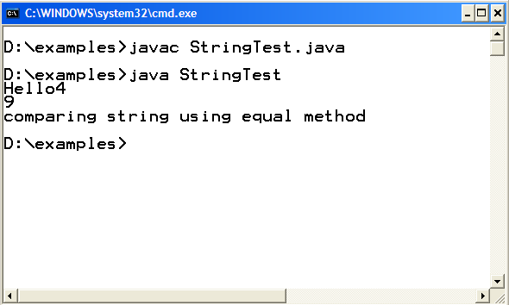
Compile and Execute

Slide 10
Taking in Command Line Arguments

Slide 11
Taking in Command Line Arguments
/* This program will take two arguments Hello World from the command prompt and prints them to standard console. If you specify less than two arguments an exception will be thrown */
public class TwoArgsApp {
  public static void main(String[] args) {
  //Displays the first argument on console
  System.out.println(“First argument “ + args[0]);
  //Displays the second argument on console
  System.out.println(“Second argument “ + args[1]);
  }
  }

Slide 12
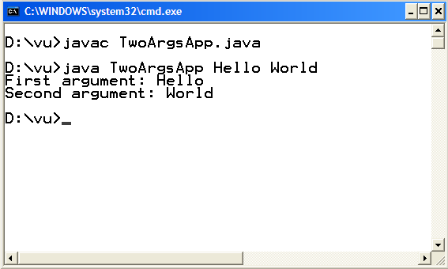
Compile and Execute

Slide 13
Passing any Number of Arguments
/* This program is able to receive any number of arguments and prints them to console using for loop. In java, arrays knows about their size by using length property
*/
public class AnyArgsApp {
public static void main(String[] args) {
  for (int i=0; i<args.length; i++)
  {
  // The “+” operator here works similar to “<<“ operator in C++. This line is // equivalent to cout<<“Arguments:”<<i<<“value”<<args[i];
  // where cout is replaced by System.out.println, and “<<“ is replaced by + for // concatenation
  System.out.println(“Argument:” + i + “value: ” + args[i] );
}
}
}

Slide 14
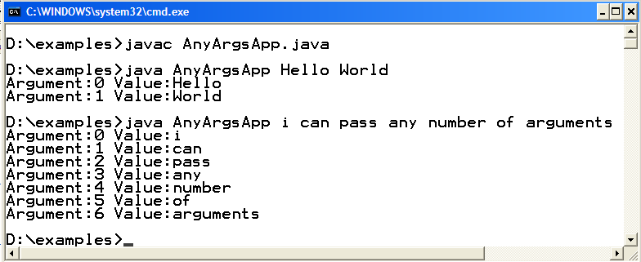
Compile and Execute

Slide 15
Primitives Vs. Objects

Slide 16
Primitives Vs. Objects
Everything in Java is an “Object”, as every class by default inherits from class “Object” , except a few primitive data types, which are there for efficiency reasons.
Primitive Data Types
  8 Primitive Data types of java
    boolean, byte → 1 byte
    char, short → 2 bytes
    int, float → 4 bytes
    long, double → 8 bytes
Primitive data types are generally used for local variables, parameters and instance variables (properties of an object)
Primitive datatypes are located on the stack and we can only access their value, while objects are located on heap and we have a reference to these objects
Also primitive data types are always passed by value while objects are always passed by reference in java. There is no C++ like methods
  void someMethod(int &a, int & b ) // not available in java

Slide 17
Primitives (cont)
For all built-in primitive data types java uses lowercase. E.g int , float etc
Primitives can be stored in arrays
You cannot get a reference to a primitive
  To do that you need an Object or a Wrapper class

Slide 18
Wrapper Classes

Slide 19
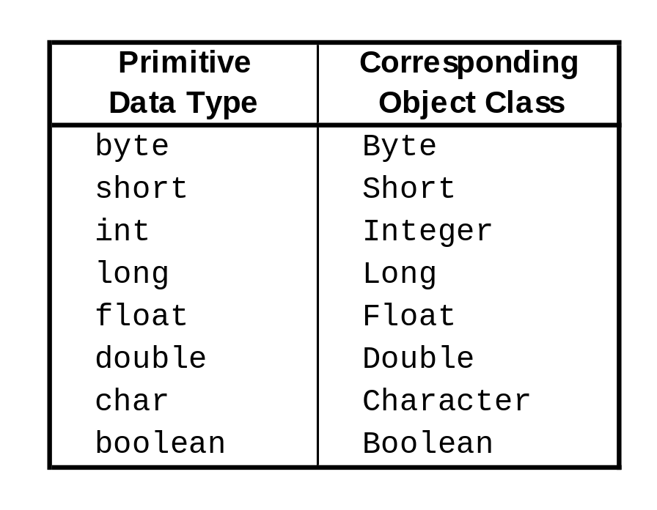
Wrapper Classes
Each primitive data type has a corresponding object (wrapper class)
These Wrapper classes provides additional functionality (conversion, size checking etc), which a primitive data type can not provide

Slide 20
Wrapper Use
You can create an object of Wrapper class using a String or a primitive data type
  Integer num = new Integer(4); or
  Integer num = new Integer(“4”);
  Num is an object over here not a primitive data type
You can get a primitive data type from a Wrapper using the corresponding value function
  int primNum = num.intValue();

Slide 21
Stack vs. Heap
Stack
Heap
public static void main(String args[])
{
int num= 5;
Integer numObj = new Integer (10);
}
num
numObj
04E2
5
10
04E2

Slide 22
Wrapper Uses
Defines useful constants for each data type
  For example,
  Integer.MAX_VALUE
Convert between data types
  Use parseXxx method to convert a String to the corresponding primitive data type
    String value = “532";
    int d = Integer.parseInt(value);
    String value = "3.14e6";
    double d = Double.parseDouble(value);

Slide 23
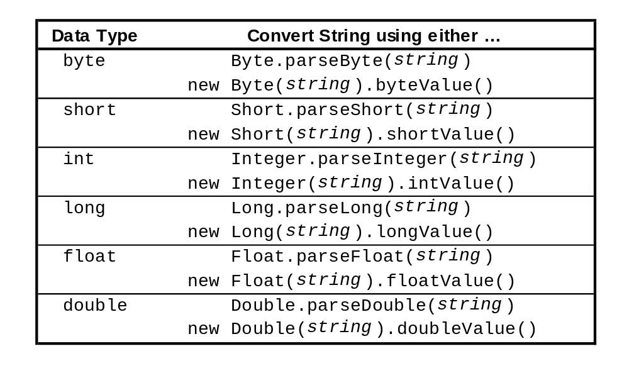
Wrappers: Converting Strings
(string)

Slide 24
Wrapper Uses
When a method does not accept an int primitive but still you need to pass an int value, you can use the corresponding Wrapper.
  someVector.add(new Integer(4) ); // this was required prior to jdk5.0
Boxing/Unboxing Conversions
  New feature added in j2se 5.0
  Boxing
    Integer iWrapper = 10;
    Prior to J2SE 5.0, we use
      Integer a = new Integer(10);
  Unboxing
    int iPrimitive = iWrapper;
    Prior to J2SE 5.0, we use
      int b = iWrapper.intValue();

Slide 25
Input / Output
/* This program will takes the input (number) through GUI and prints its square on the console as well as on the GUI. */
import javax.swing.*;
public class InputOutputTest {
public static void main(String[] args) {
//takes input through GUI
String input = JOptionPane.showInputDialog("Enter the number");
int number = Integer.parseInt(input);
int square = number * number;
//Display square on console
System.out.println("square:" + square);
//Display square on GUI
JOptionPane.showMessageDialog(null, "square:"+ square);
System.exit(0); //Don’t forget to write when using JOptionPane. Don’t need it in //J2SE 5.0
}
}

Slide 26
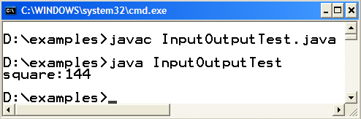
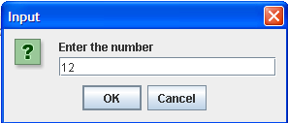
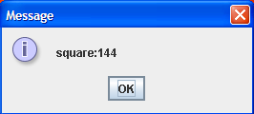
Compile and Execute

